Slide 1

Term-2 TABA Assignment
(11920041) Harika Sabbella
(11920044) Abhinav Singh
(11920046) Ravikanth MV
(11920052) Vijay Vincent
(11920087) Aditya Sai Yasaswi Sarvabhotla

Slide 2
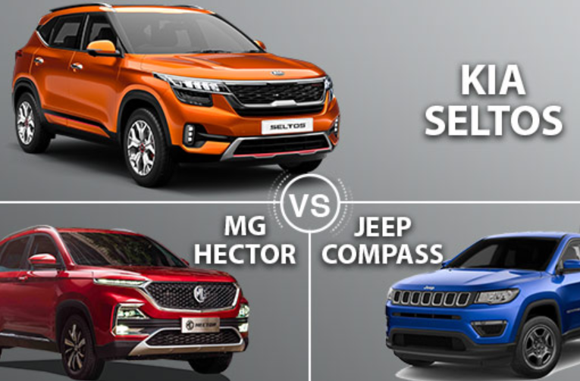
Task 1: DATA Collection (Reviews)
Models:
Kia Seltos
MG Hector
Jeep Campass
Review Source:
CarDekho.com (Website)
Fields Collected:
Car Title
Rating
Review
Reviewer Name
Date
URL ( default : Cardekho.com)

Slide 3

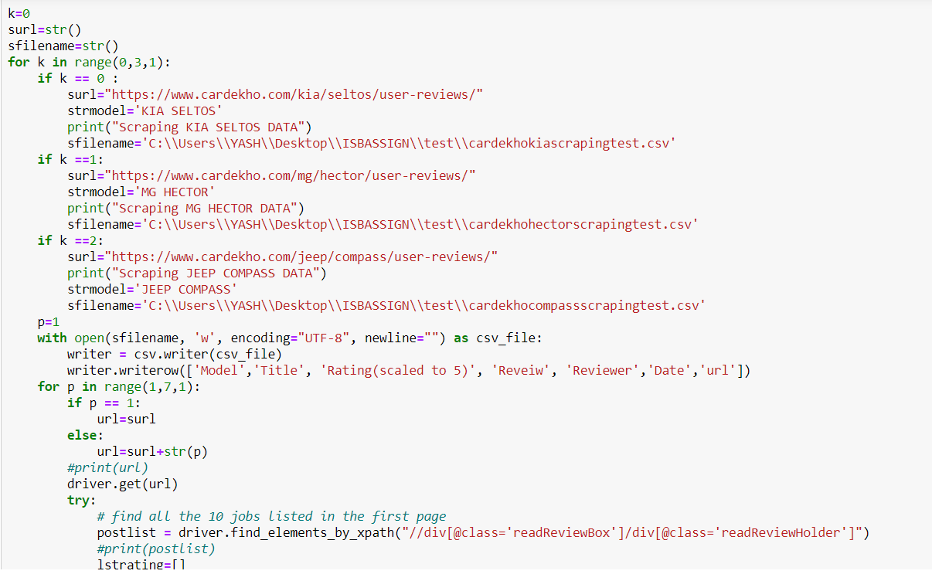
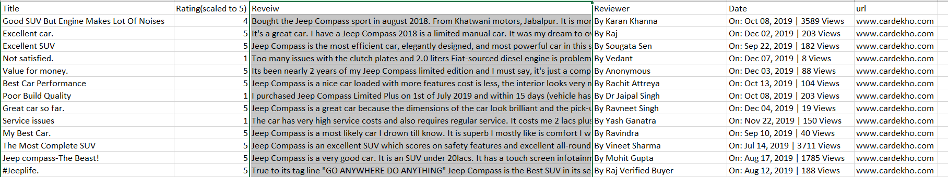
Task 1: DATA Output File
Code Snippet
Code Snippet
Output File
OutputFile

Slide 4

Task 2: Text-an of the Reviews
Data Collection
Data Processing
.
Data Analysis
Data Presentation
Data Mining
Approach

Slide 5

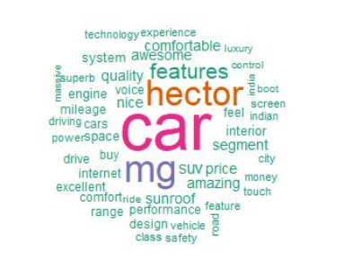
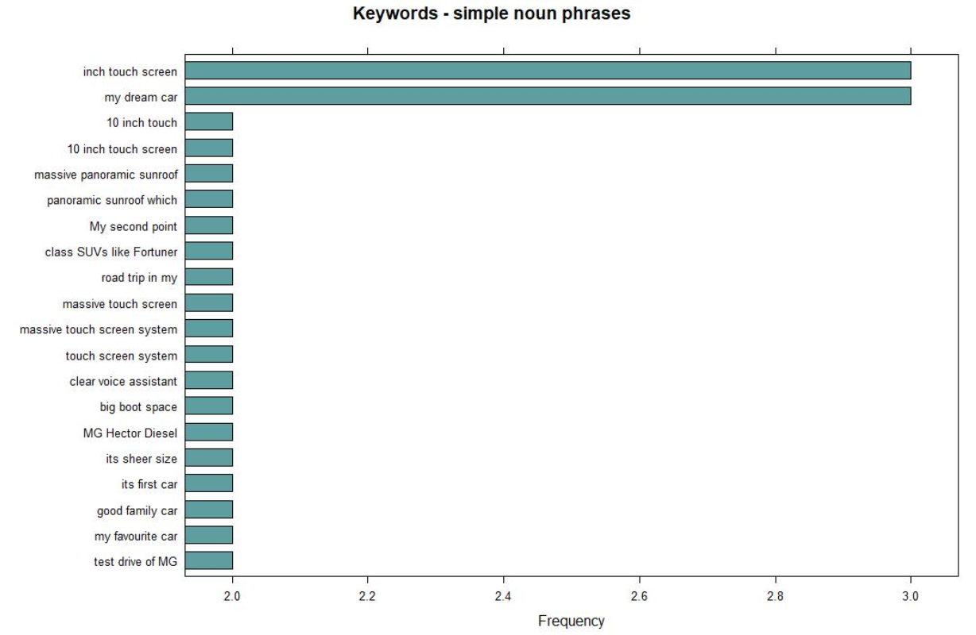
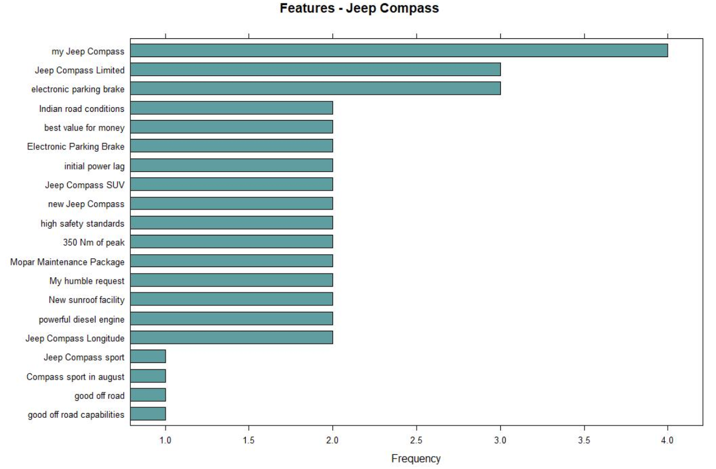
Task 2: Text-an of the Reviews
Question 1:
MG Hector is the most searched and reviewed car.
Question 2:
Question 1:
How do customers view
our product against competition?
Question 2:
On what attributes (e.g., price, buying experience) and product features (e.g., engine, interiors etc) are we perceived as Strong? Weak?
Question 3:
On what attributes (e.g., price, buying experience) and product features (e.g., engine, interiors etc) are we perceived as Strong? Weak?
As per phrases specified:
10 inch touch screen
Massive panoramic sunroof
Question 3:
As per features specified:
sunroof
performance
quality
price

Slide 6

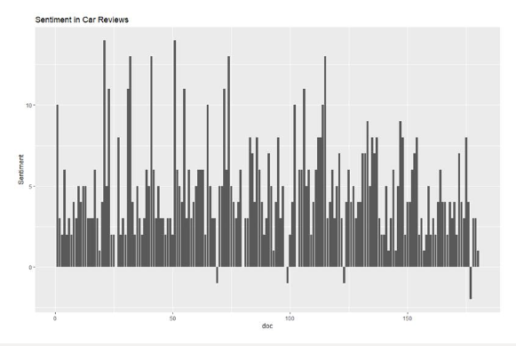
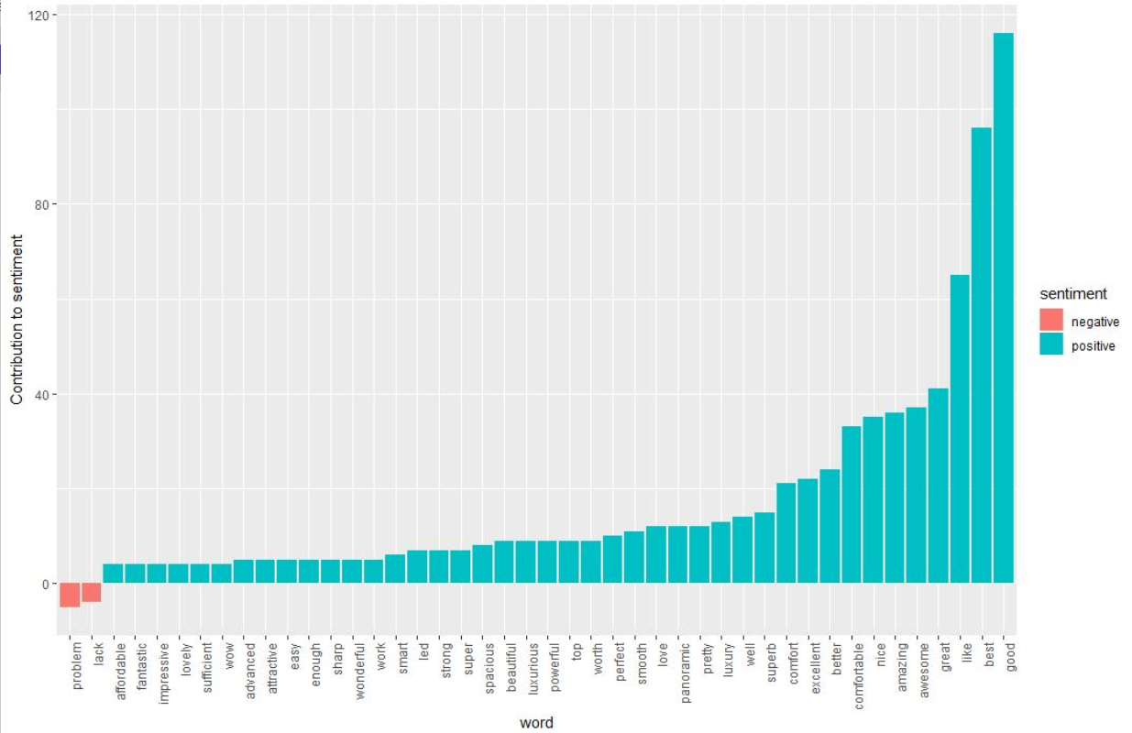
Task 2: Text-an of the Reviews
Question 4:
Question 5:
Following are attributes specified based on the emotions/response from the customers for MG Hector
As per features specified:
sunroof
performance
quality
price
As per phrases specified:
10 inch touch screen
Massive panoramic sunroof
Based on the analysis , drive, road, mileage, quality, experience, KM are some of the key features that
MG is lacking as compared to Jeep Compass. Hence MG Hector have to improve its mileage to survive in the Market.
Question 4:
What attributes or product features seem to best evoke an 'emotional' response or connect from customers?
Question 5:
How should we position ourselves and promote our product against competition?

Slide 7

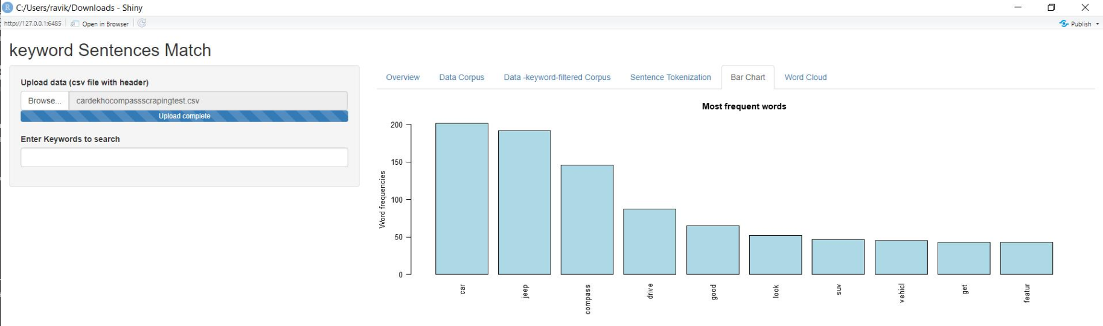
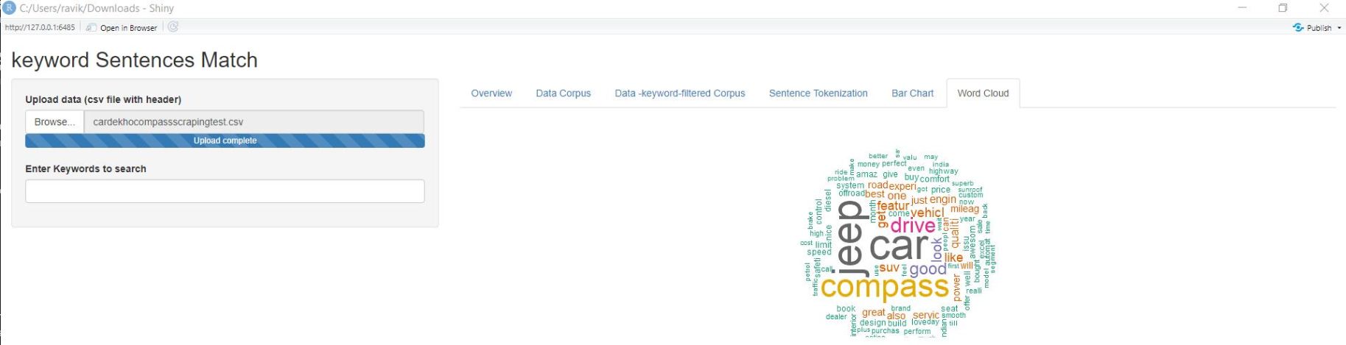
Task 3: Shinny App
Bar Chart :
Shinny App Home page
Bar Chart: Relative frequencies of the occurrence of the keywords in your corpus
Word Cloud
Word cloud:

Slide 8

Recommendations to the client
The key features of MG hector are : 10 inch touch screen , Massive panoramic sunroof ,performance, quality & price.
Comparing Mileage: Jeep Compass is better than MG Hector.
Customers looking for the above-mentioned features must go for MG Hectors.

